Slide 1
Relational Algebra
Notes:
The slides for this text are organized into several modules. Each lecture contains about enough material for a 1.25 hour class period. (The time estimate is very approximate--it will vary with the instructor, and lectures also differ in length; so use this as a rough guideline.) This covers Lecture 2 (of 6) in Module (3).
Module (1): Introduction (DBMS, Relational Model)
Module (2): Storage and File Organizations (Disks, Buffering, Indexes)
Module (3): Database Concepts (Relational Queries, DDL/ICs, Views and Security)
Module (4): Relational Implementation (Query Evaluation, Optimization)
Module (5): Database Design (ER Model, Normalization, Physical Design, Tuning)
Module (6): Transaction Processing (Concurrency Control, Recovery)
Module (7): Advanced Topics

Slide 2
Relational Query Languages
Query languages: Allow manipulation and retrieval of data from a database.
Relational model supports simple, powerful QLs:
  Strong formal foundation based on logic.
  Allows for much optimization.
Query Languages != programming languages!
  QLs not expected to be “Turing complete”.
  QLs not intended to be used for complex calculations.
  QLs support easy, efficient access to large data sets.

Slide 3
Formal Relational Query Languages
Two mathematical Query Languages form the basis for “real” languages (e.g. SQL), and for implementation:
Relational Algebra: More operational, very useful for representing execution plans.
Relational Calculus: Lets users describe what they want, rather than how to compute it. (Non-operational, declarative.)
Understanding Algebra & Calculus is key to
understanding SQL, query processing!

Slide 4
Preliminaries
A query is applied to relation instances, and the result of a query is also a relation instance.
  Schemas of input relations for a query are fixed (but query will run regardless of instance!)
  The schema for the result of a given query is also fixed! Determined by definition of query language constructs.
Positional vs. named-field notation:
  Positional notation easier for formal definitions, named-field notation more readable.
  Both used in Relational Algebra and SQL

Slide 5
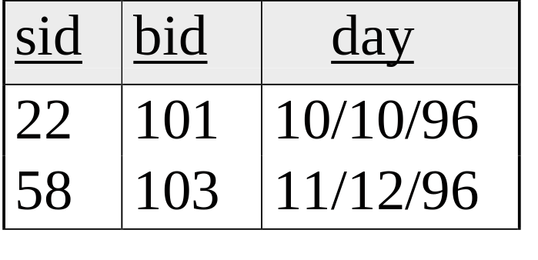
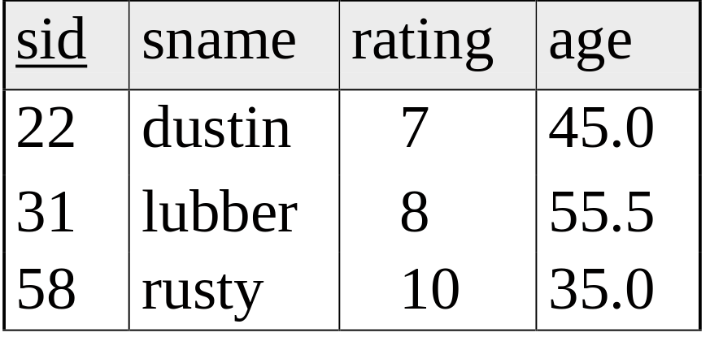
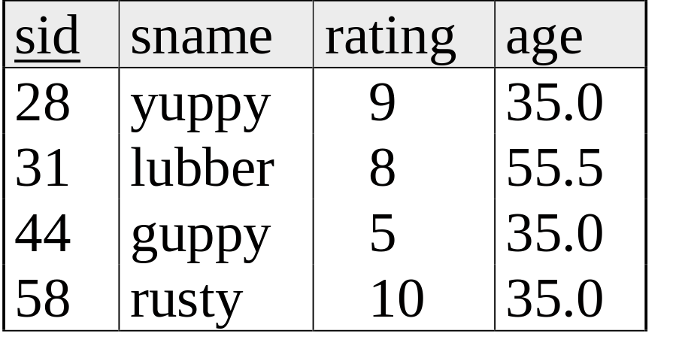
Example Instances
R1
“Sailors” and “Reserves” relations for our examples.
We’ll use positional or named field notation, assume that names of fields in query results are `inherited’ from names of fields in query input relations.
S1
S2

Slide 6

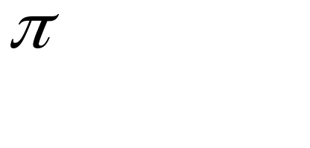


Relational Algebra
Basic operations:
  Selection ( ) Selects a subset of rows from relation.
  Projection ( ) Deletes unwanted columns from relation.
  Cross-product ( ) Allows us to combine two relations.
  Set-difference ( ) Tuples in reln. 1, but not in reln. 2.
  Union ( ∪ ) Tuples in reln. 1 and in reln. 2.
Additional operations:
  Intersection, join, division, renaming: Not essential, but (very!) useful.
Since each operation returns a relation, operations can be composed! (Algebra is “closed”.)

Slide 7
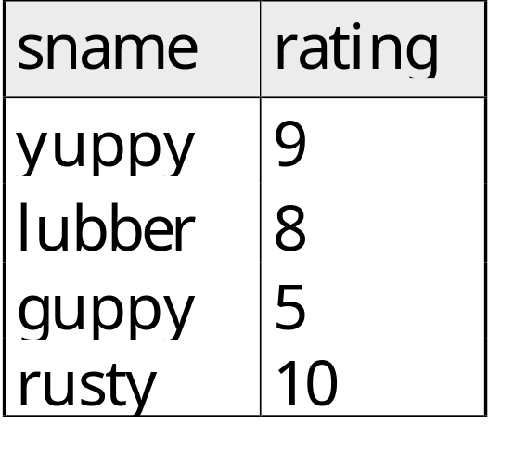
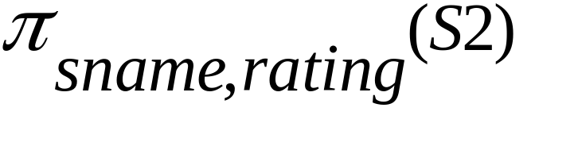
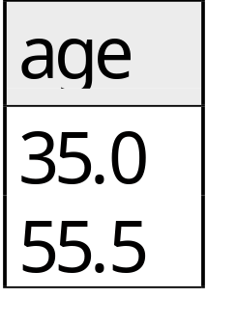
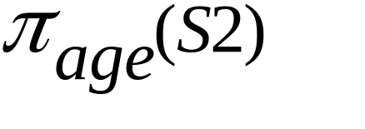
Projection
Deletes attributes that are not in projection list.
Schema of result contains exactly the fields in the projection list, with the same names that they had in the (only) input relation.
Projection operator has to eliminate duplicates! (Why??)
  Note: real systems typically don’t do duplicate elimination unless the user explicitly asks for it. (Why not?)

Slide 8
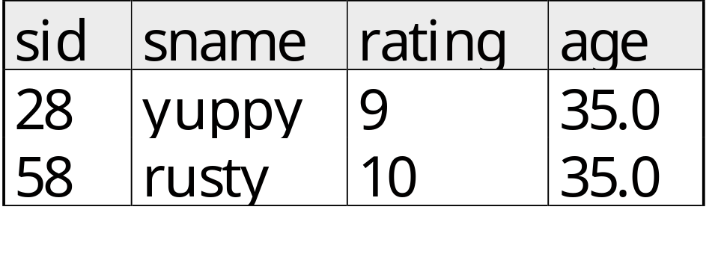
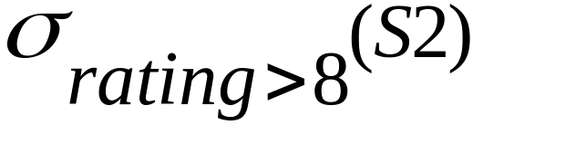
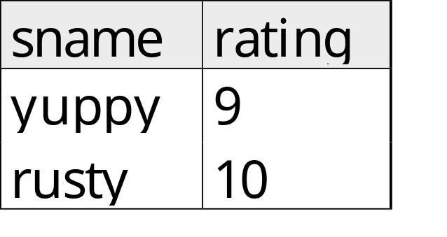
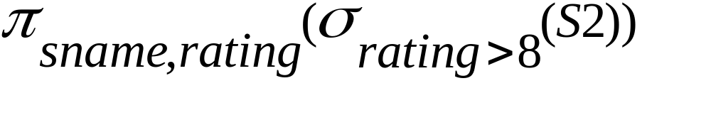
Selection
Selects rows that satisfy selection condition.
No duplicates in result! (Why?)
Schema of result identical to schema of (only) input relation.
Result relation can be the input for another relational algebra operation! (Operator composition.)

Slide 9
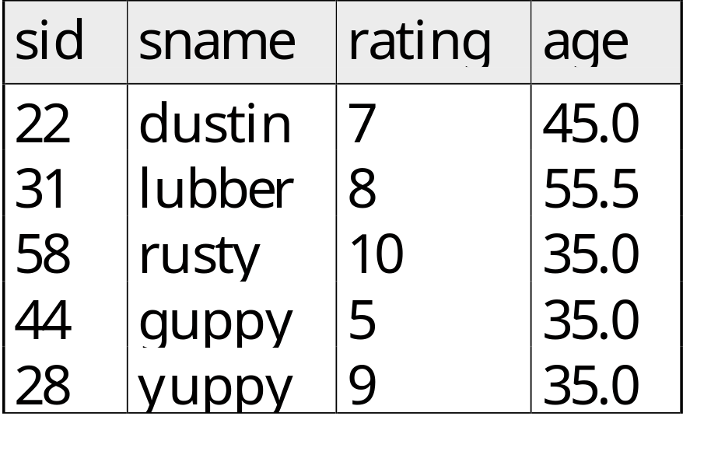

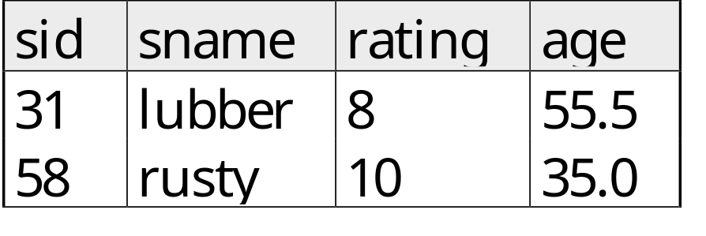
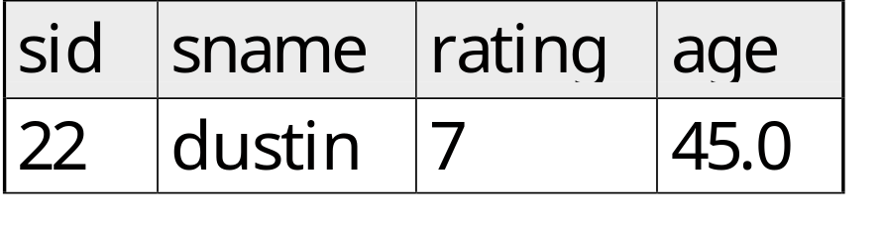


Union, Intersection, Set-Difference
All of these operations take two input relations, which must be union-compatible:
  Same number of fields.
  `Corresponding’ fields have the same type.
What is the schema of result?

Slide 10
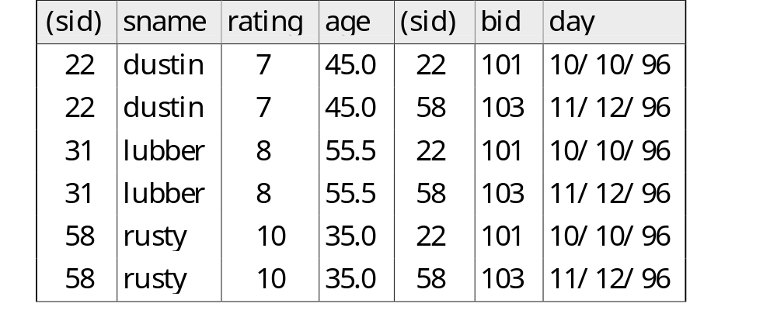
Cross-Product
Each row of S1 is paired with each row of R1.
Result schema has one field per field of S1 and R1, with field names `inherited’ if possible.
  Conflict: Both S1 and R1 have a field called sid.
Renaming operator:

Slide 11

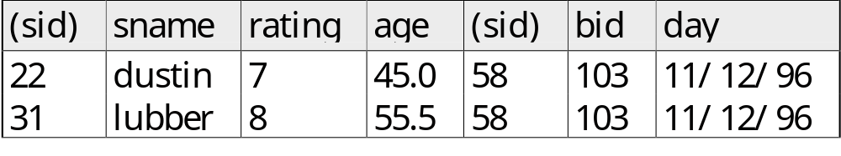
Joins
Condition Join: R _{C} S = σ_{C} (R × S)
S1 _{S1.sid < R1.sid} R1
Result schema same as that of cross-product.
Fewer tuples than cross-product, might be able to compute more efficiently
Sometimes called a theta-join.

Slide 12
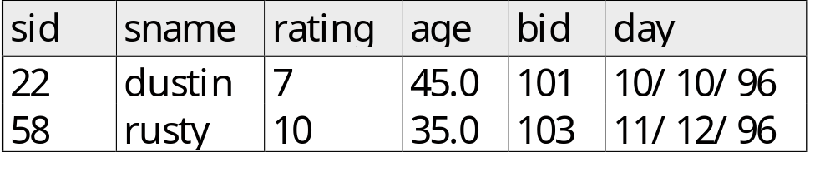
Joins
Equi-Join: A special case of condition join where the condition c contains only equalities and ^.
S1 _{sid} R1
Result schema similar to cross-product, but only one copy of fields for which equality is specified.
Natural Join: Equijoin on all common fields.

Slide 13
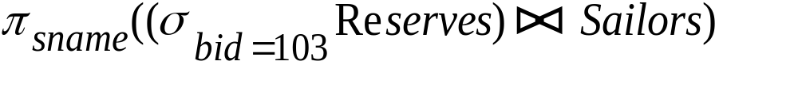
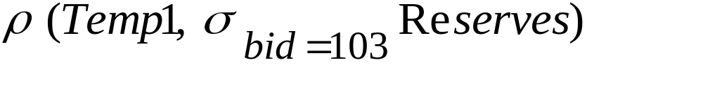
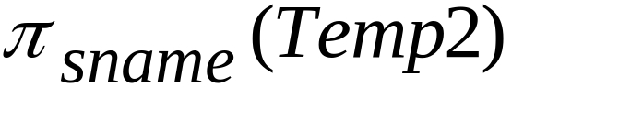
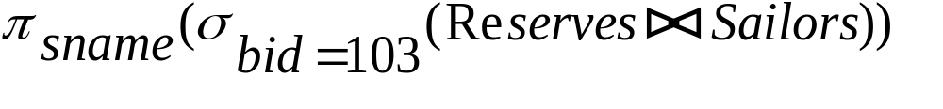
Find names of sailors who’ve reserved boat #103
Solution 1:
Solution 2:
Solution 3:

Slide 14
Find names of sailors who’ve reserved a red boat
Information about boat color only available in Boats; so need an extra join:
A more efficient solution:
A query optimizer can find this given the first solution!

Slide 15


Find sailors who’ve reserved a red or a green boat
Can identify all red or green boats, then find sailors who’ve reserved one of these boats:
Can also define Tempboats using union! (How?)
What happens if is replaced by in this query?

Slide 16
Find sailors who’ve reserved a red and a green boat
Previous approach won’t work! Must identify sailors who’ve reserved red boats, sailors who’ve reserved green boats, then find the intersection (note that sid is a key for Sailors):

Slide 17
Relational Calculus

Slide 18
Relational Calculus
Comes in two flavors: Tuple relational calculus (TRC) and Domain relational calculus (DRC).
Calculus has variables, constants, comparison ops, logical connectives, and quantifiers.
  TRC: Variables range over (i.e., get bound to) tuples.
  DRC: Variables range over domain elements (= field values).
  Both TRC and DRC are simple subsets of first-order logic.
Expressions in the calculus are called formulas. An answer tuple is essentially an assignment of constants to variables that make the formula evaluate to true.

Slide 19
Tuple Relational Calculus
Query has the form: { T | p(T)}
Answer includes all tuples T that
make the formula p(T) be true.
Formula is recursively defined, starting with
simple atomic formulas (getting tuples from
relations or making comparisons of values),
and building bigger and better formulas using
the logical connectives.

Slide 20
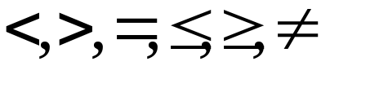
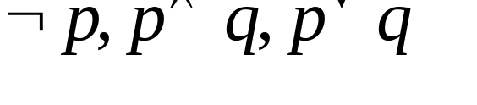
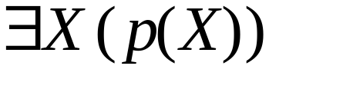
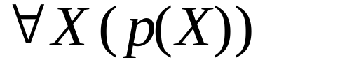
TRC Formulas
Atomic formula:
  R ∈ Rel, or R.a op S.b, or R.a op constant
  op is one of
Formula:
  an atomic formula, or
  , where p and q are formulas, or
  , where variable X is free in p(X), or
  , where variable X is free in p(X)

Slide 21
Free and Bound Variables
The use of quantifiers ∀X and ∃X in a formula is said to bind X.
  A variable that is not bound is free.
Let us revisit the definition of a query: {T|p(T)}
There is an important restriction: the variable T that appears to the left of `|’ must be the only free variable in the formula p(...).

Slide 22
Find all sailors with a rating above 7
{S | S ∈ Sailors ^ S.rating > 7}
Query is evaluated on an instance of Sailors
Tuple variable S is instantiated to each tuple of this instance in turn, and the condition “S.rating > 7” is applied to each such tuple.
Answer contains all instances of S (which are tuples of Sailors) satisfying the condition.

Slide 23
Find sailors rated > 7 who’ve reserved boat #103
{S | (S ∈ Sailors) ^ (S.rating > 7) ^ (∃ R ∈ Reserves (R.sid = S.sid ^ R.bid = 103))}
Note the use of ∃ to find a tuple in Reserves that `joins with’ the Sailors tuple under consideration.
R is bound, S is not

Slide 24
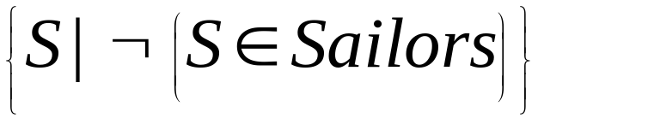
Unsafe Queries, Expressive Power
It is possible to write syntactically correct calculus queries that have an infinite number of answers! Such queries are called unsafe.
  e.g.,
It is known that every query that can be expressed in relational algebra can be expressed as a safe query in DRC / TRC; the converse is also true.
Relational Completeness: Query language (e.g., SQL) can express every query that is expressible in relational algebra/calculus.

Slide 25
Summary
The relational model has rigorously defined query languages that are simple and powerful.
Relational algebra is more operational; useful as internal representation for query evaluation plans.
Relational calculus is non-operational, and users define queries in terms of what they want, not in terms of how to compute it. (Declarativeness.)
Several ways of expressing a given query; a query optimizer should choose the most efficient version.
Algebra and safe calculus have same expressive power, leading to the notion of relational completeness.

Slide 26
Nested Relations
Attributes can be scalar (as before) or relation-valued
Definition is recursive
Example: create table Book (title: string, author:string, copies: (publ: string, pages: integer, date: integer))
“copies” is a relation-valued field

Slide 27
Nested Relational Algebra
A spectrum of algebras can be defined
At one end:
  Relational algebra plus nest (ν) and unnest (μ): If B =
title
author
copies
publ
pages
date
Moby Dick
Melville
Prentice Hall
613
1971
McGraw Hill
542
1942
Marmion
Scott
{ }

Slide 28
Nesting and Unnesting
… then μ (B, copies) =
title
author
publ
pages
date
Moby Dick
Melville
Prentice Hall
613
1971
Moby Dick
Melville
McGraw Hill
542
1942
Marmion
Scott
null
null
null
Nulls must be supported in algebra
ν (μ (B, copies), copies (publ, pages, date)) = B
ν, μ inverses iff S → N
  S is set of scalar fields
  N is set of non-scalar fields
  This is called PNF (partitioned normal form)

Slide 29
Extending Relational Operators
At other end of spectrum:
  Selection allows set comparators and constants and use of select, project inside the formula
  Projection allows arbitrary NF2 algebra expression in addition to simple field names
  Union, difference: recursive definitions
  Cross product: usually just relational.
Example: retrieve title, number of pages of all books by Melville:
  π[title, π[pages](copies)](σ[author=‘Melville’](B))

Slide 30
Nested Relations Summary
An early step on the way to OODBMS
No products, only prototypes, but:
  Many ideas from NF2 relations have survived
  Collection types in SQL3 (nesting, unnesting)
  Algebra ideas useful for Object Database QP
Can provide a more natural model of data
Are a straightforward extension of relations:
  many solutions are thus also straightforward
  formal foundation of relational model remains

